Slide 1

Better Public Services Towards Wellbeing with Digital Public Infrastructure (aka Open Source Building Blocks for Government)
Tony Shannon
Head of Digital Services
Office of Government Chief Information Officer

Slide 2


Slide 3
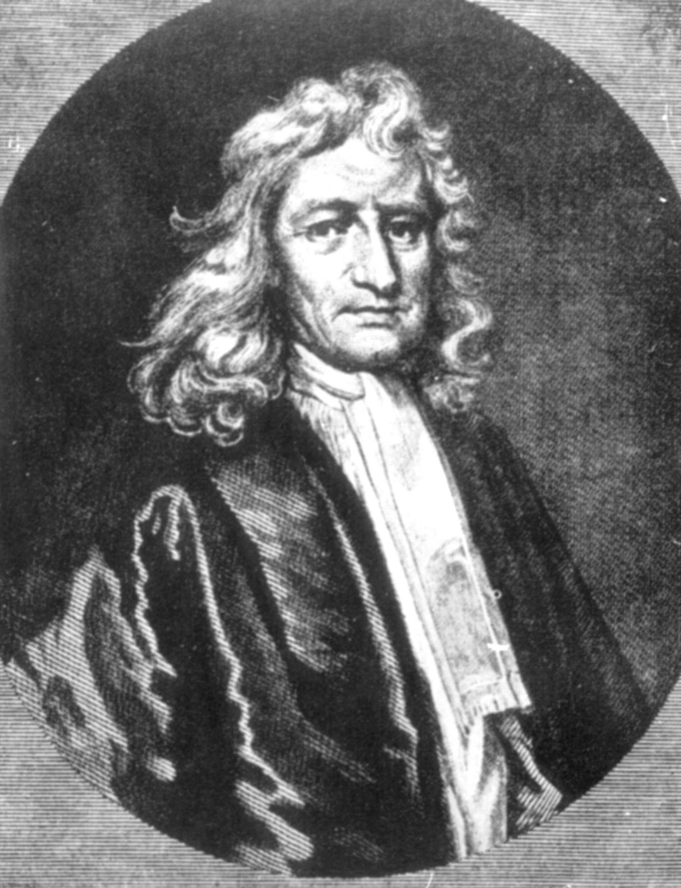
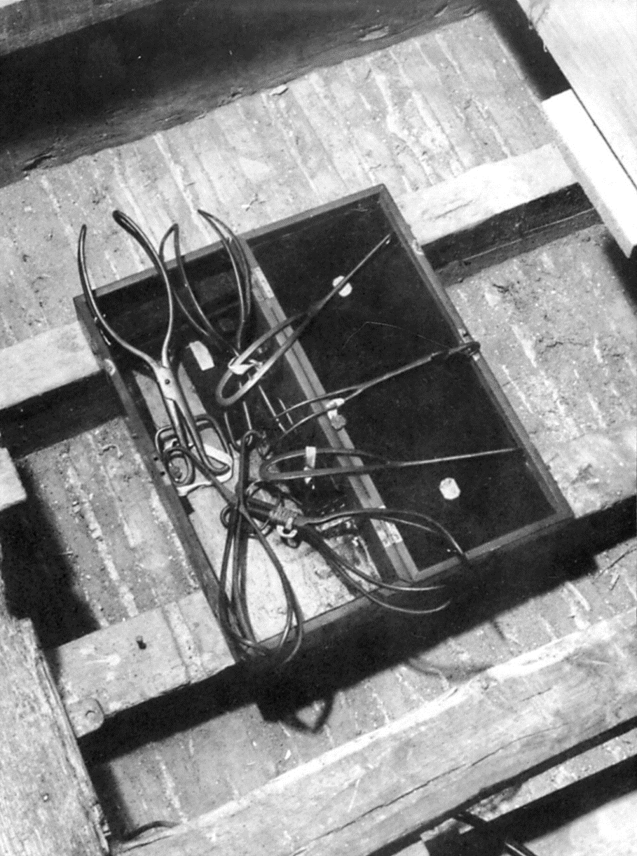
One Story…

Slide 4
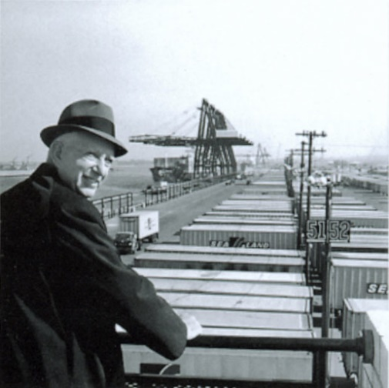

Another Story…

Slide 5
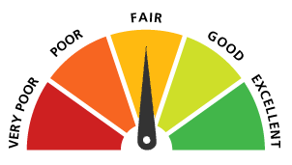
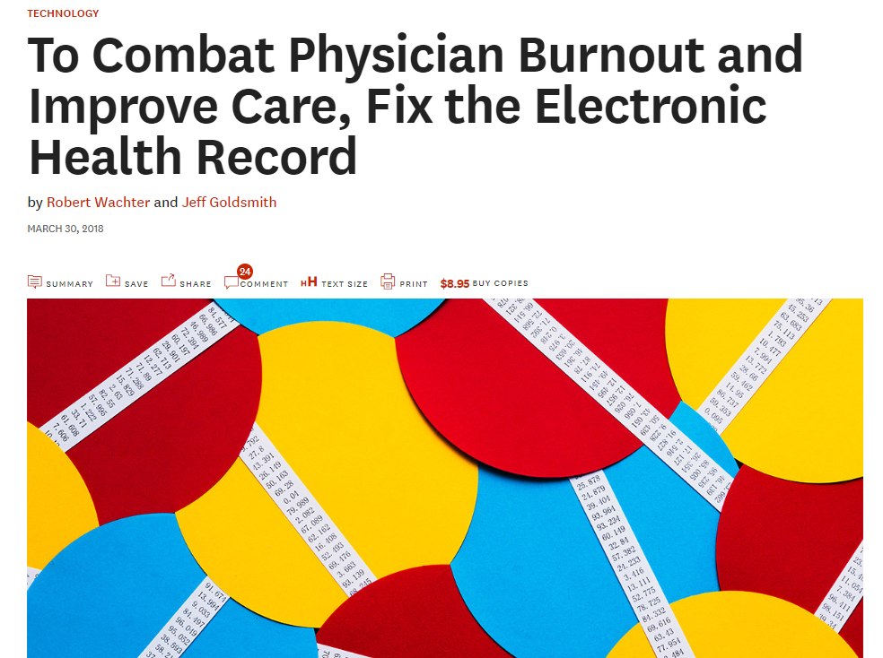
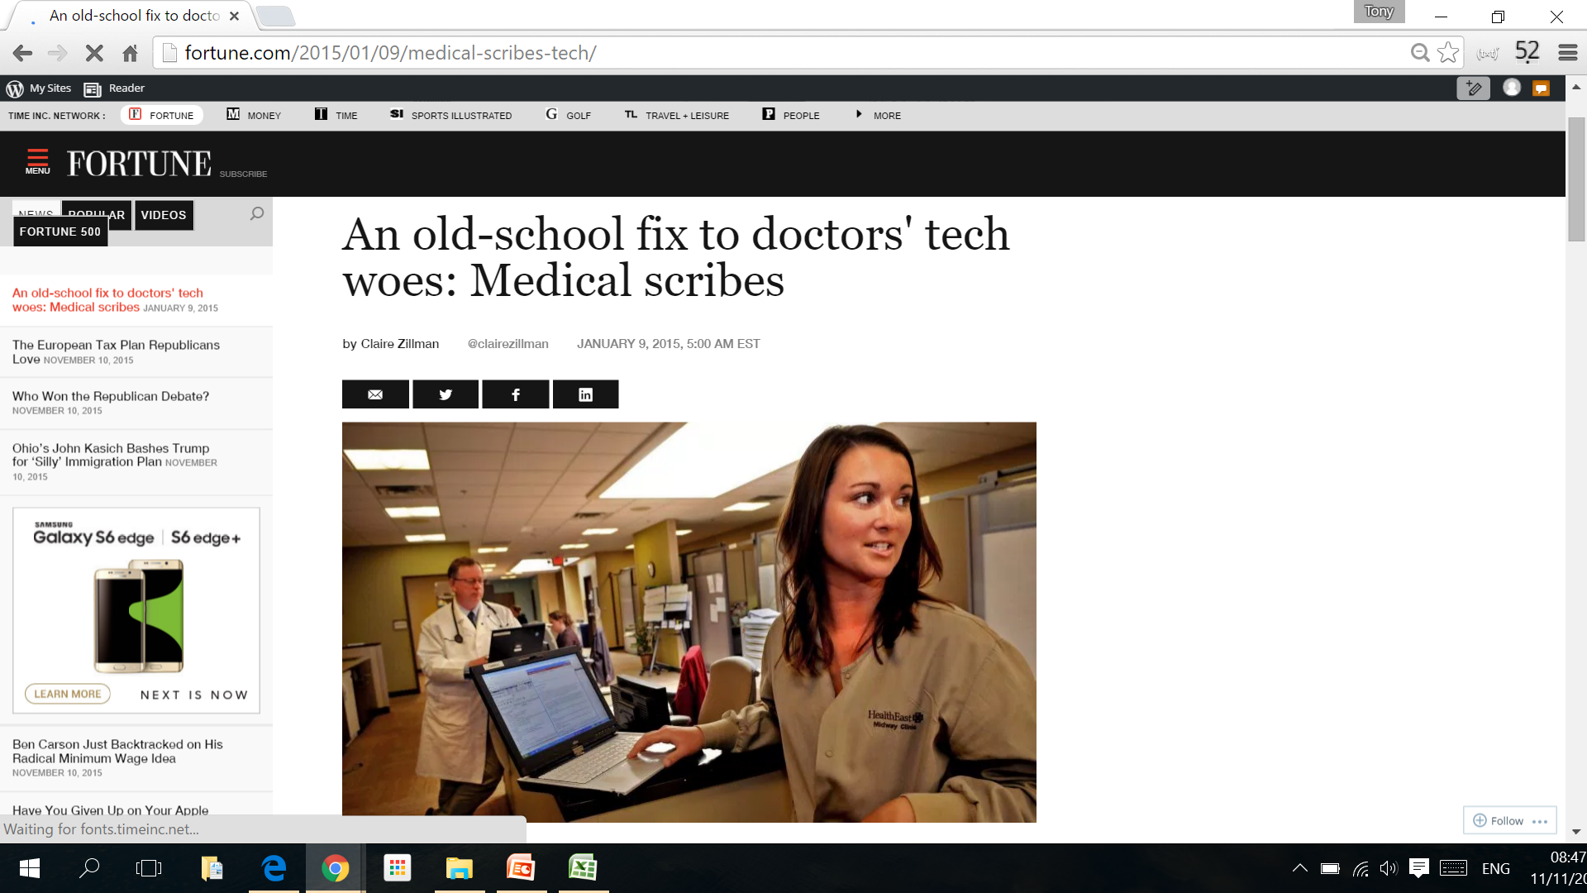
Notes:
Tony
Ireland/UK/USA in EM
State of EM & EM IT
Scribes
Poor state not good enough

Slide 6






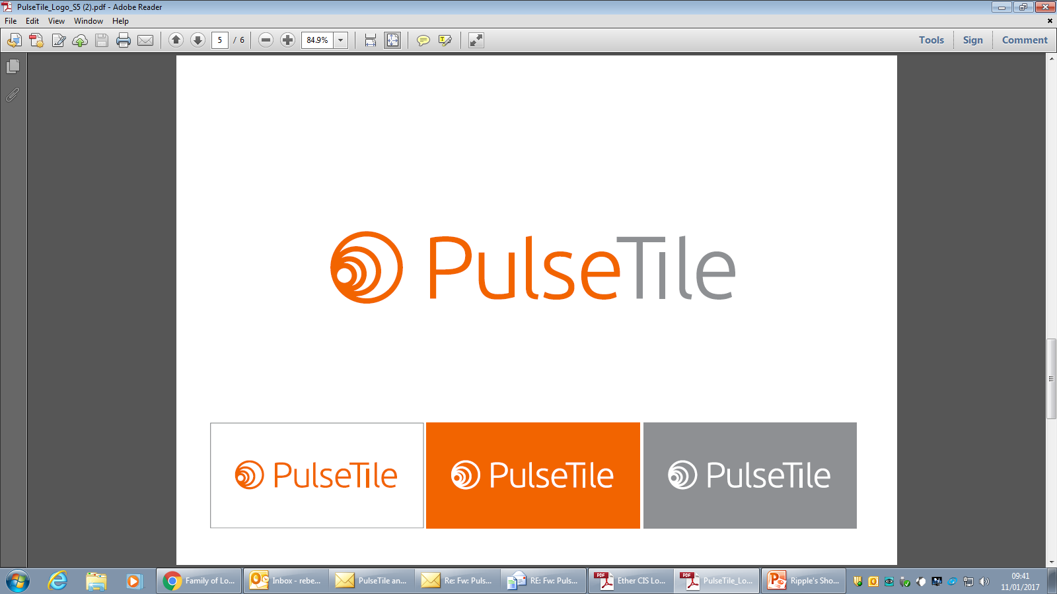


Icons designed by Freepik.com
User Interface
Health Information Exchange
Clinical Data Repository
Ripple Foundation C.I.C Ltd
Private & Confidential

Slide 7

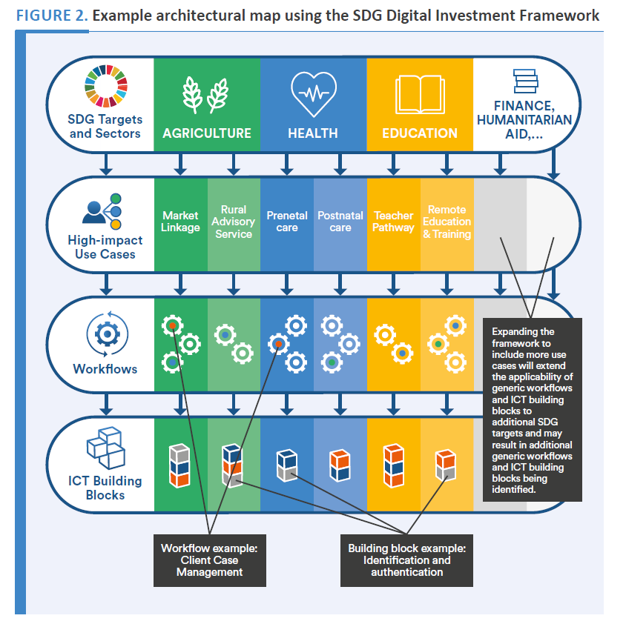
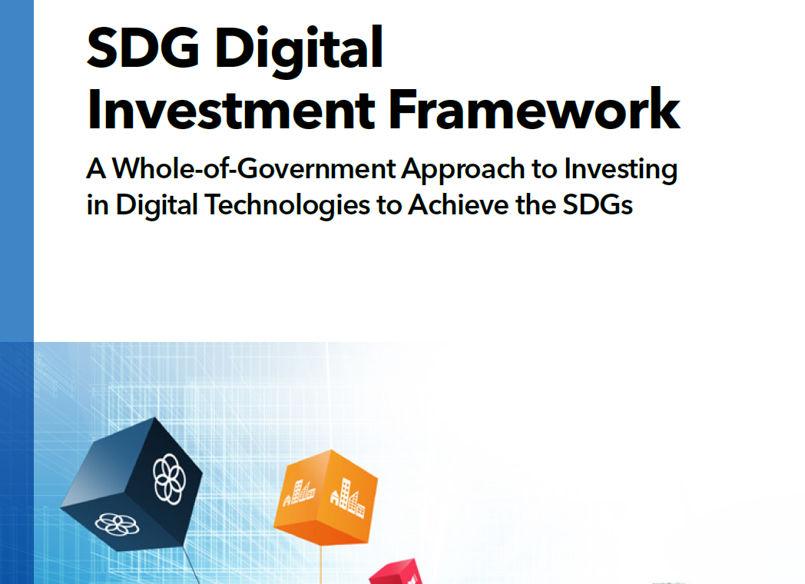

Slide 8
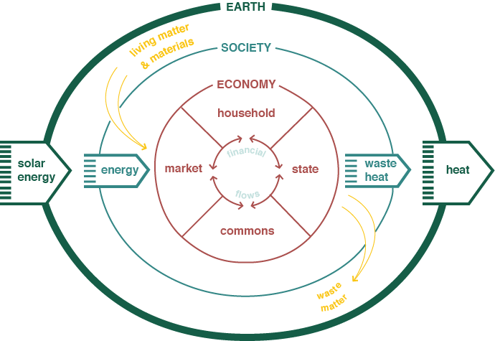
21st Century SocioEconomics

Slide 9

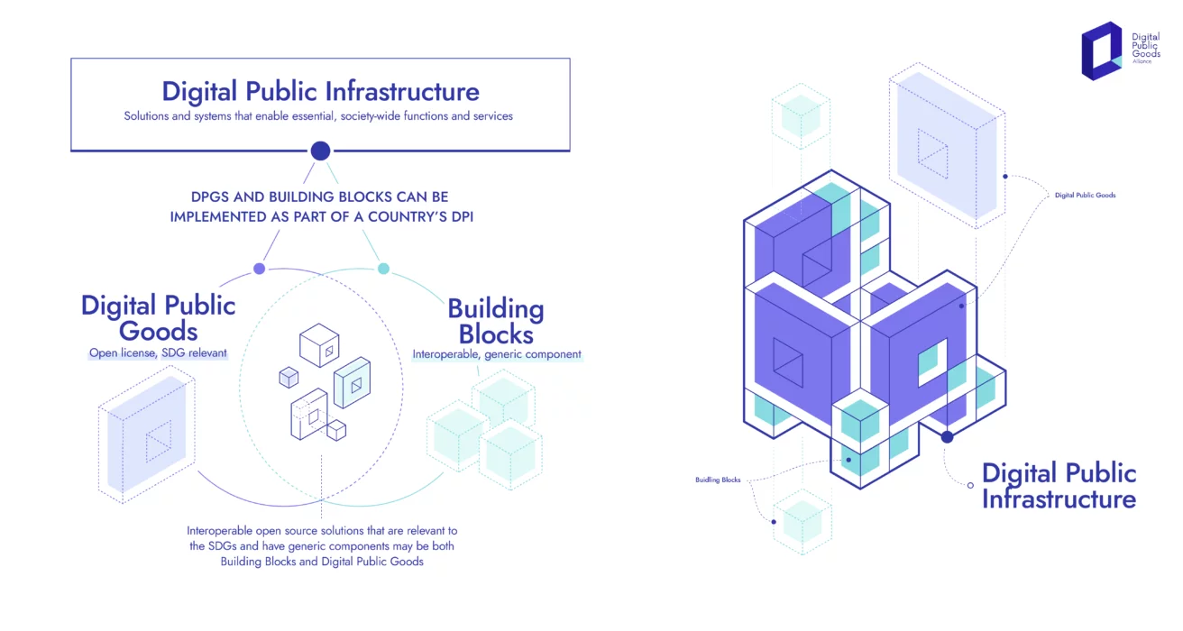

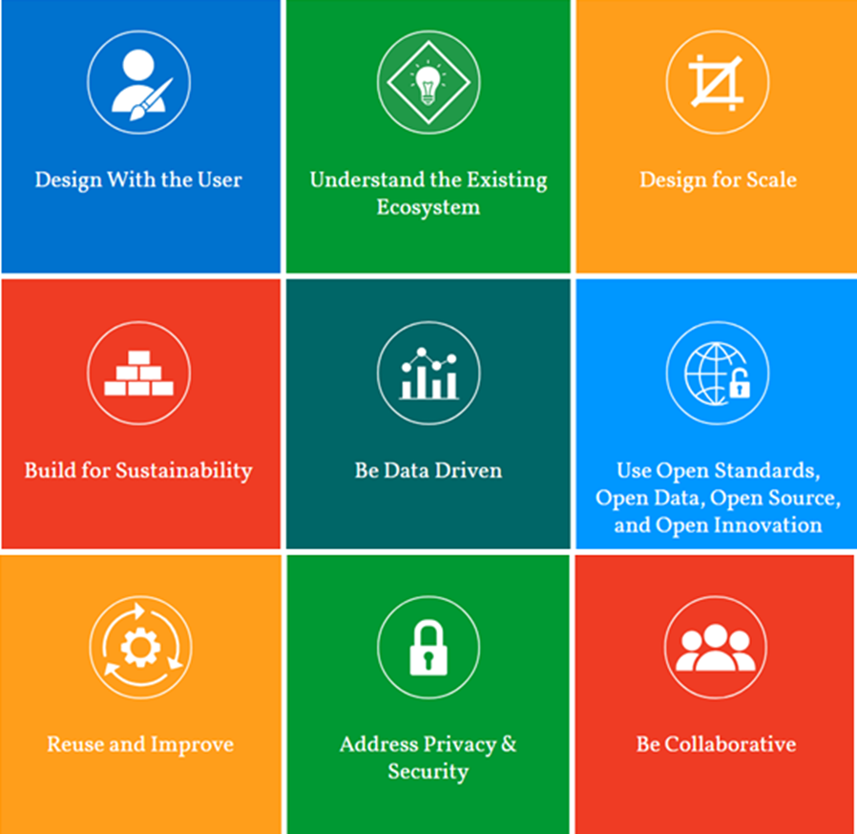

Slide 10
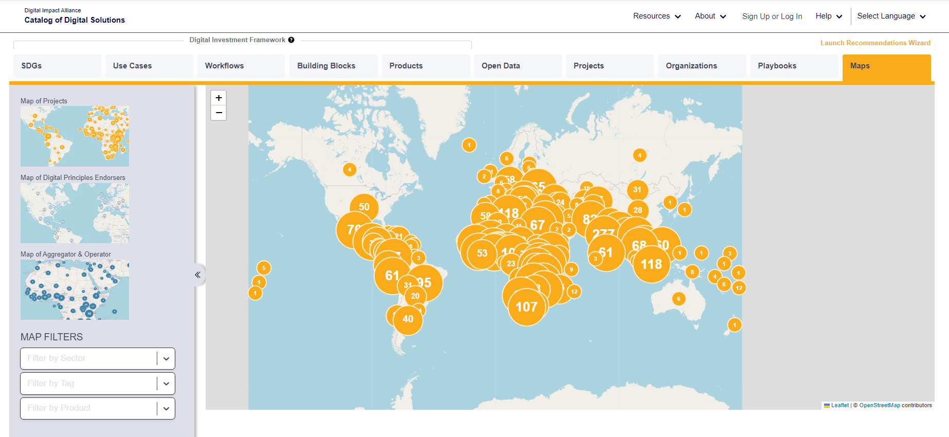

Slide 11
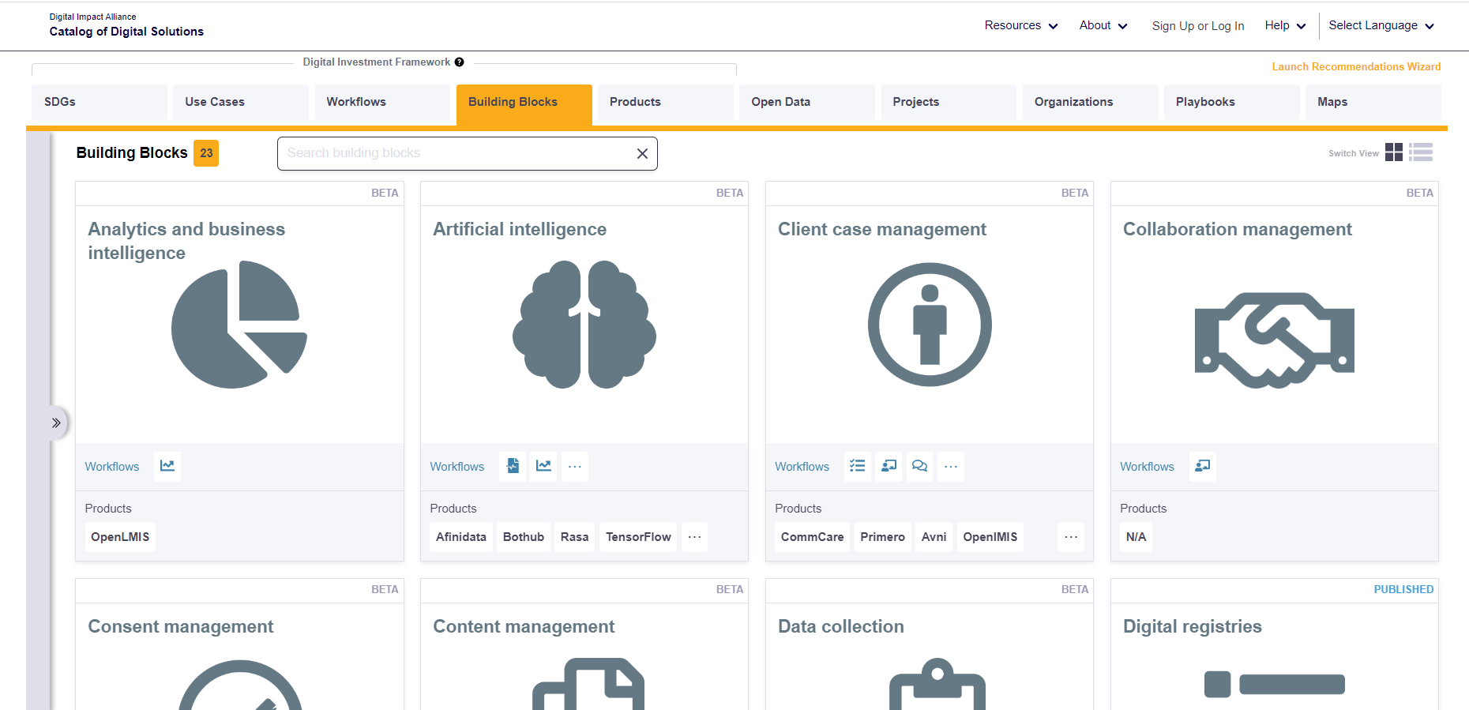

Components in the Commons

Slide 12



Towards 2030: Decade of Digital & Green
9

Slide 14


Digital and Innovation at Scale
The Public Service will work together to
Tackle big societal issues and drive societal change
Achieve a seamless user experience and inclusive service delivery
Provide a dynamic and agile workplace
A Public Service that:
Builds trust in public institutions
Focuses on outcomes
Delivers climate action and sustainability

Slide 15









Life Events
Life events refer to significant experiences or changes in an individual's life that can have a profound impact on their circumstances and/or well-being. These events often necessitate interactions with multiple services or agencies
Renting, Buying,
Moving House
Having a baby &
early childhood
Owning &
Driving a Car
Setting up a
Business
Finding &
losing a job
Moving to
Ireland
Marriage/
Divorce
End
of life

Slide 16
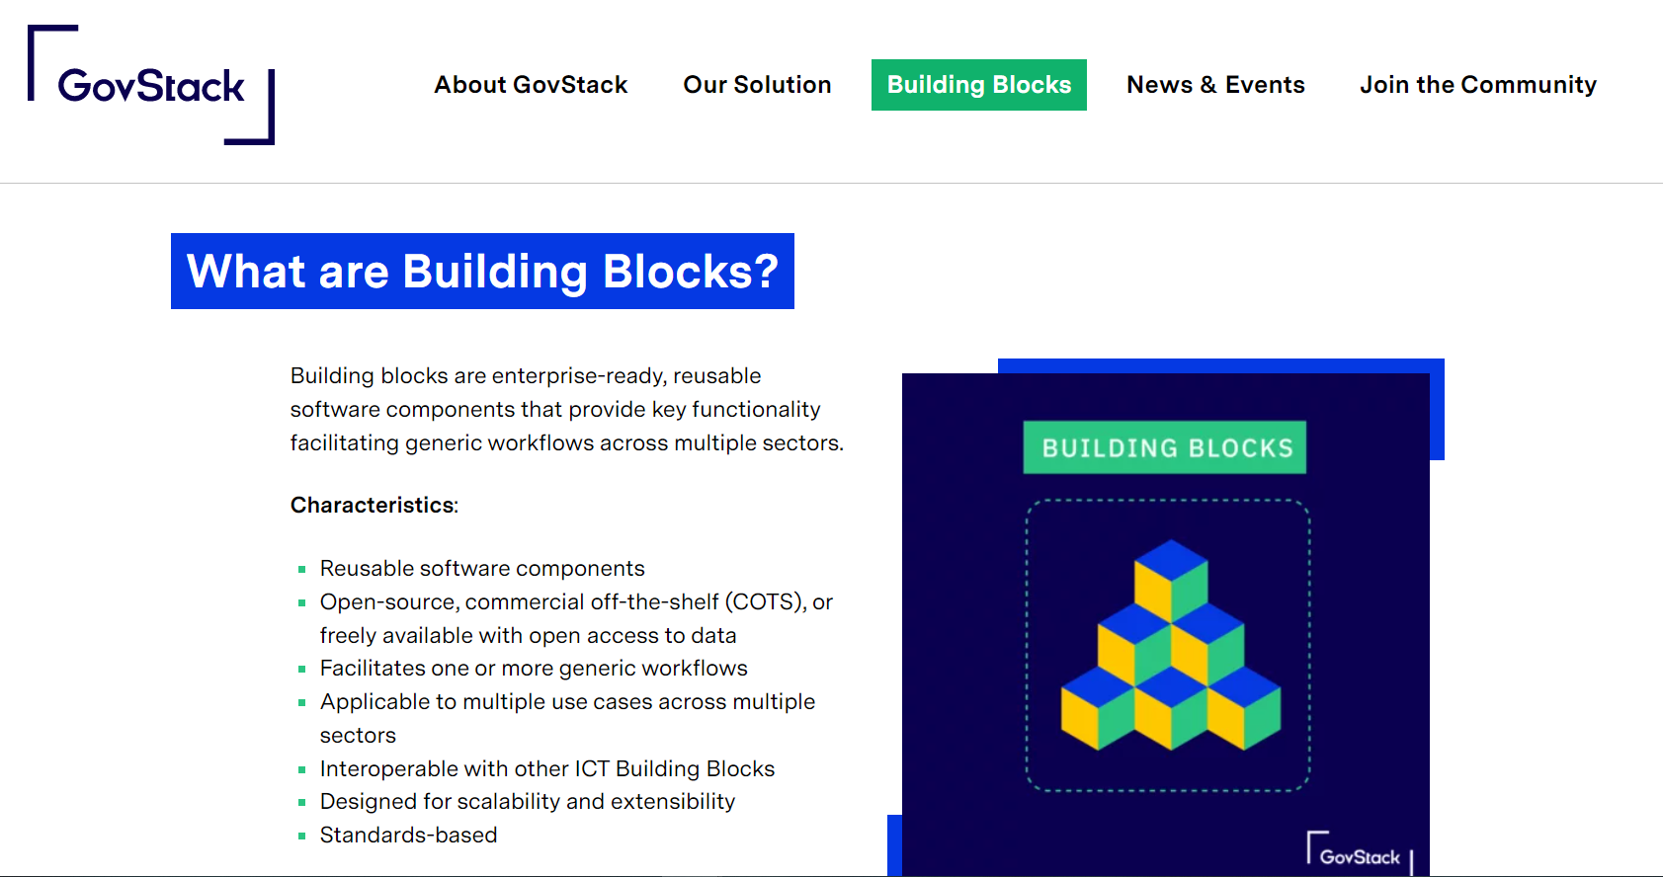


Slide 17
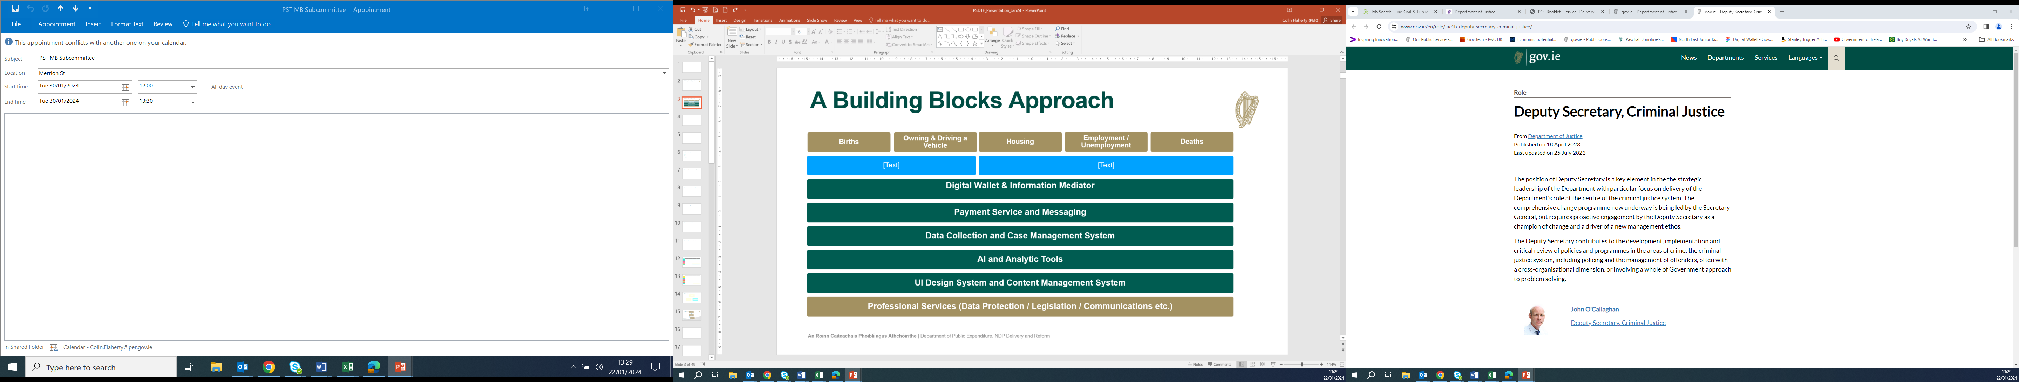
Life Events: Building Blocks Approach

Slide 18



Policy & Analysis
Design & Content
Applications & Architecture
Assurance
Operations
Service Provider - Storm
Service Provider- Global Logic
Service Provider - Nearform

Slide 19
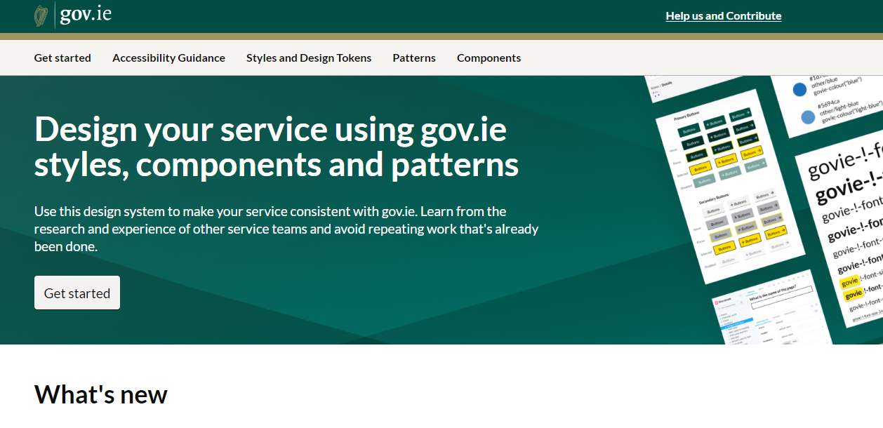
Design: Design System

Slide 20

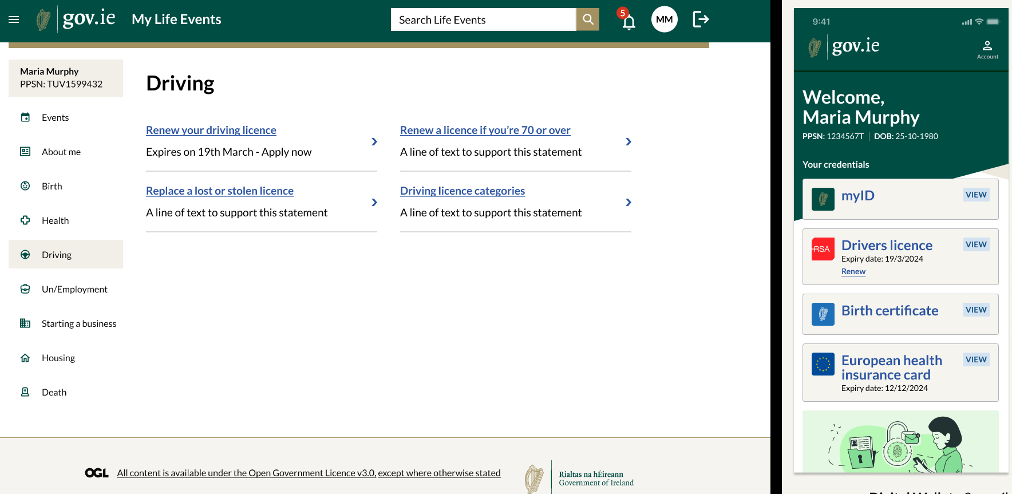

Slide 21

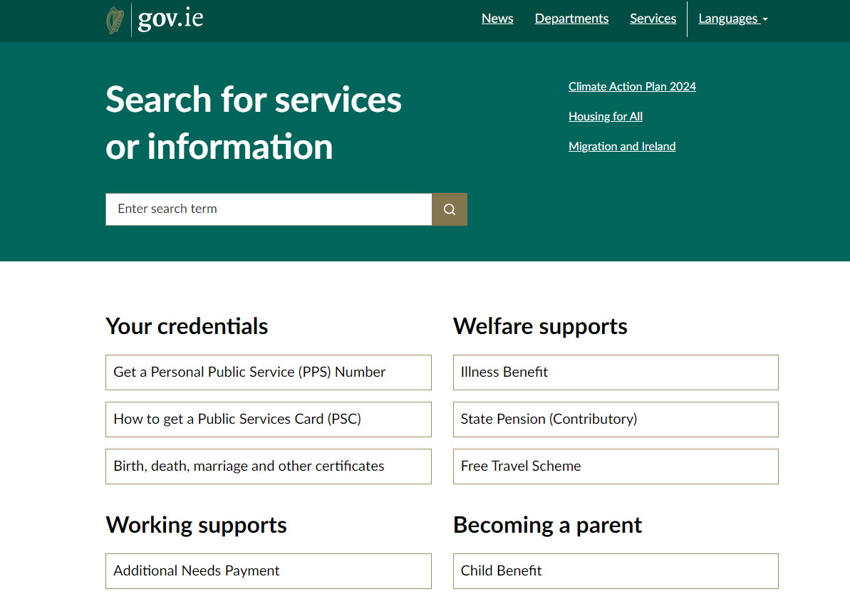
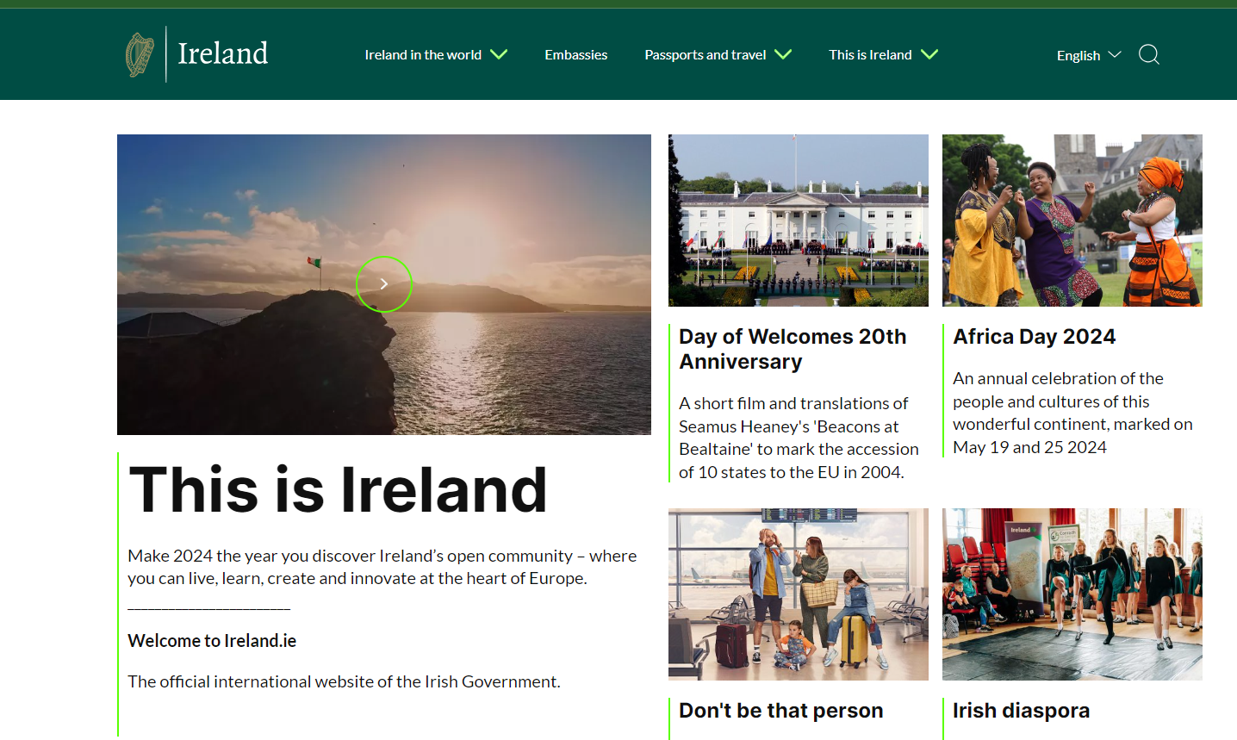
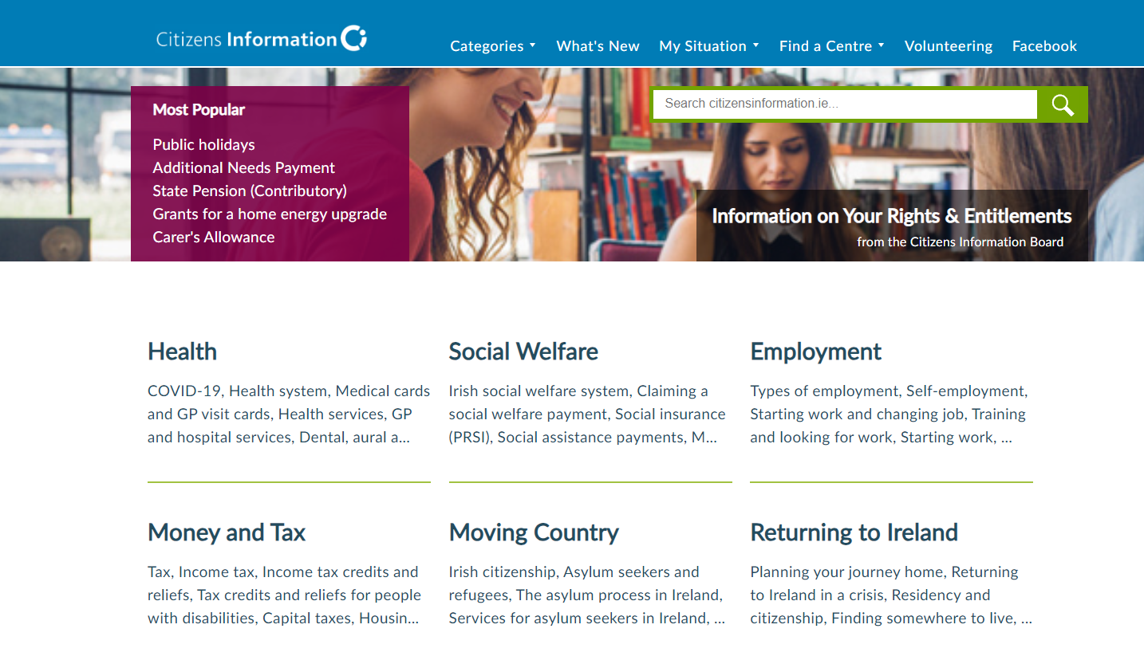
Gov.ie

Slide 22
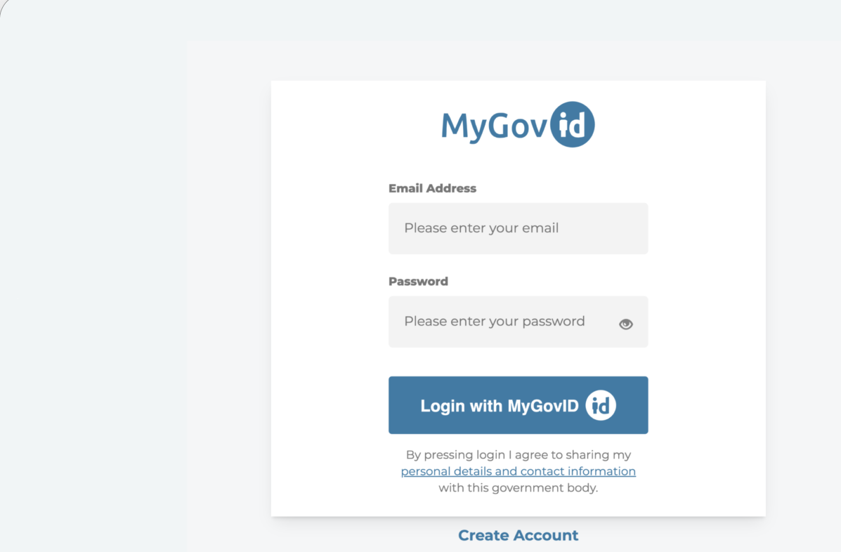
MyGovID

Slide 23
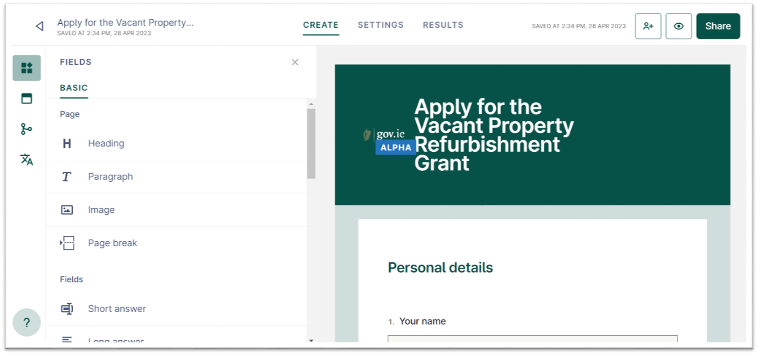
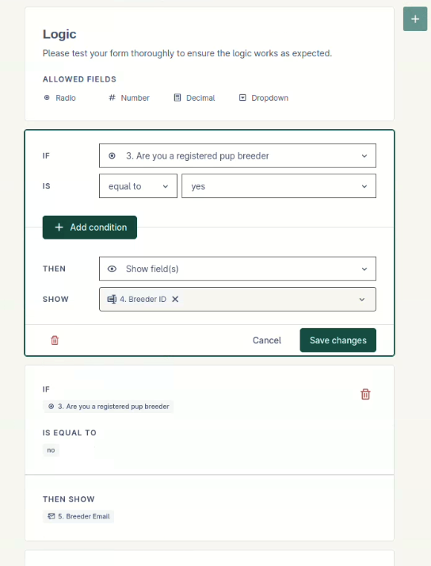
FormsIE : Data Collection

Slide 24
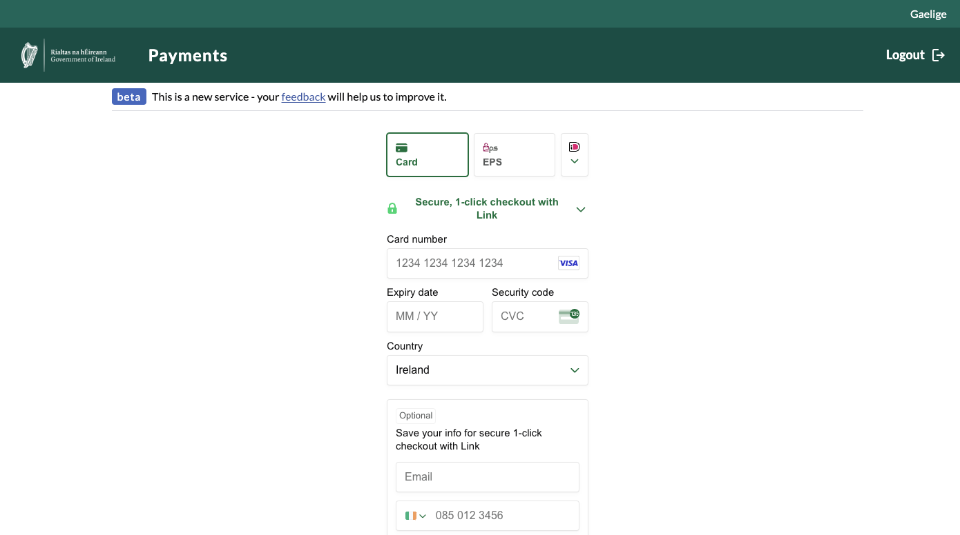
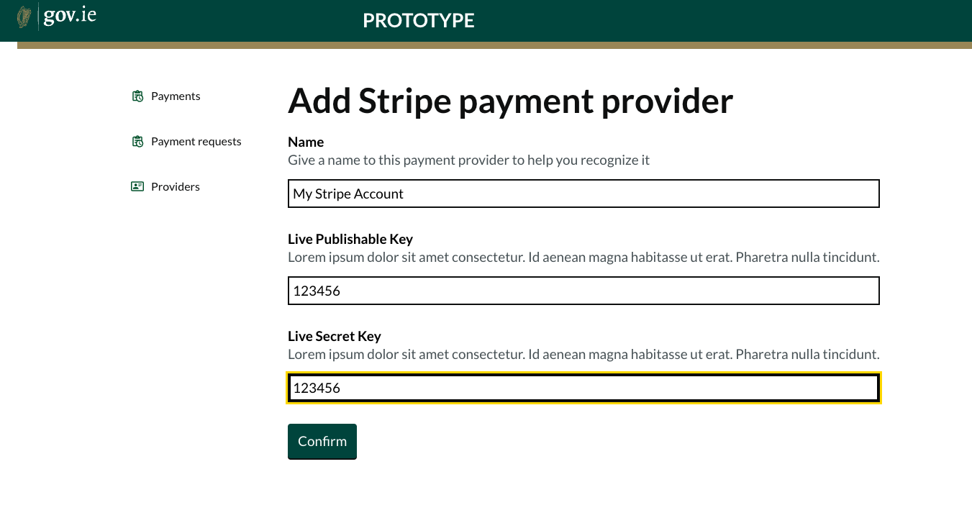
Payments: Collect & Manage

Slide 25
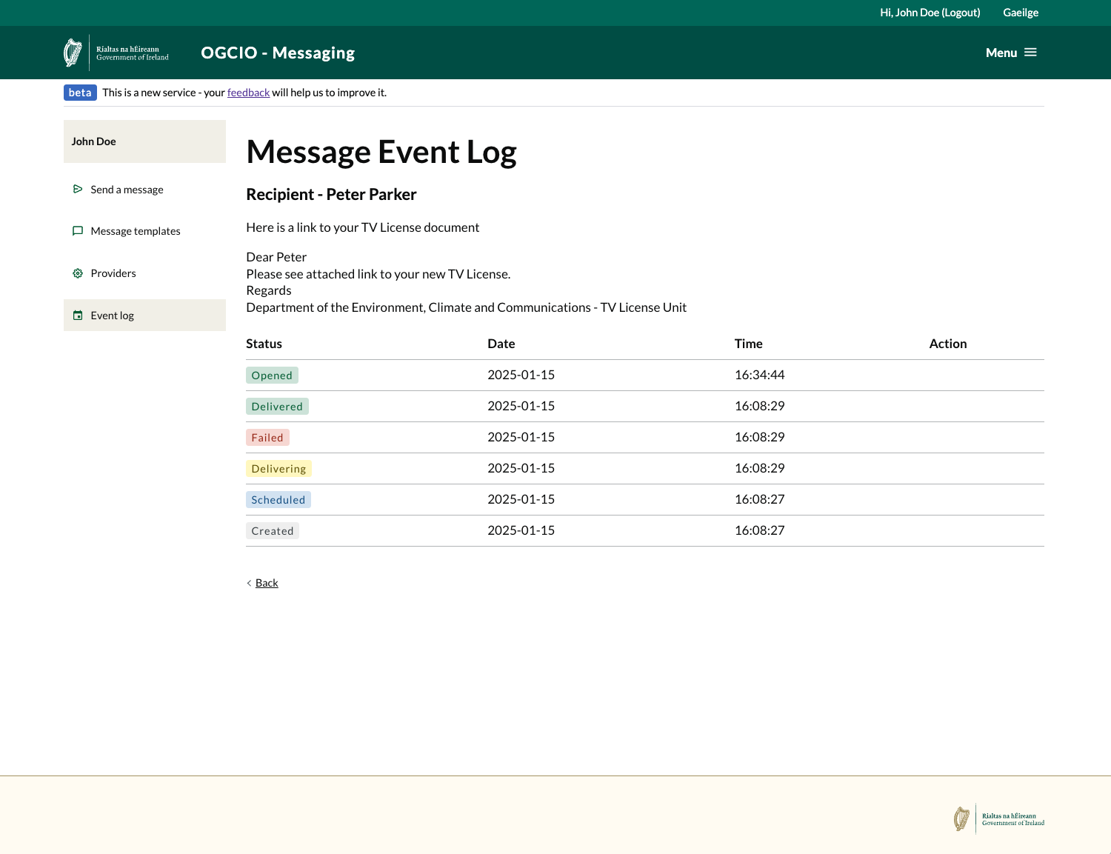
Messaging: Notifications – eMail/ SMS

Slide 26
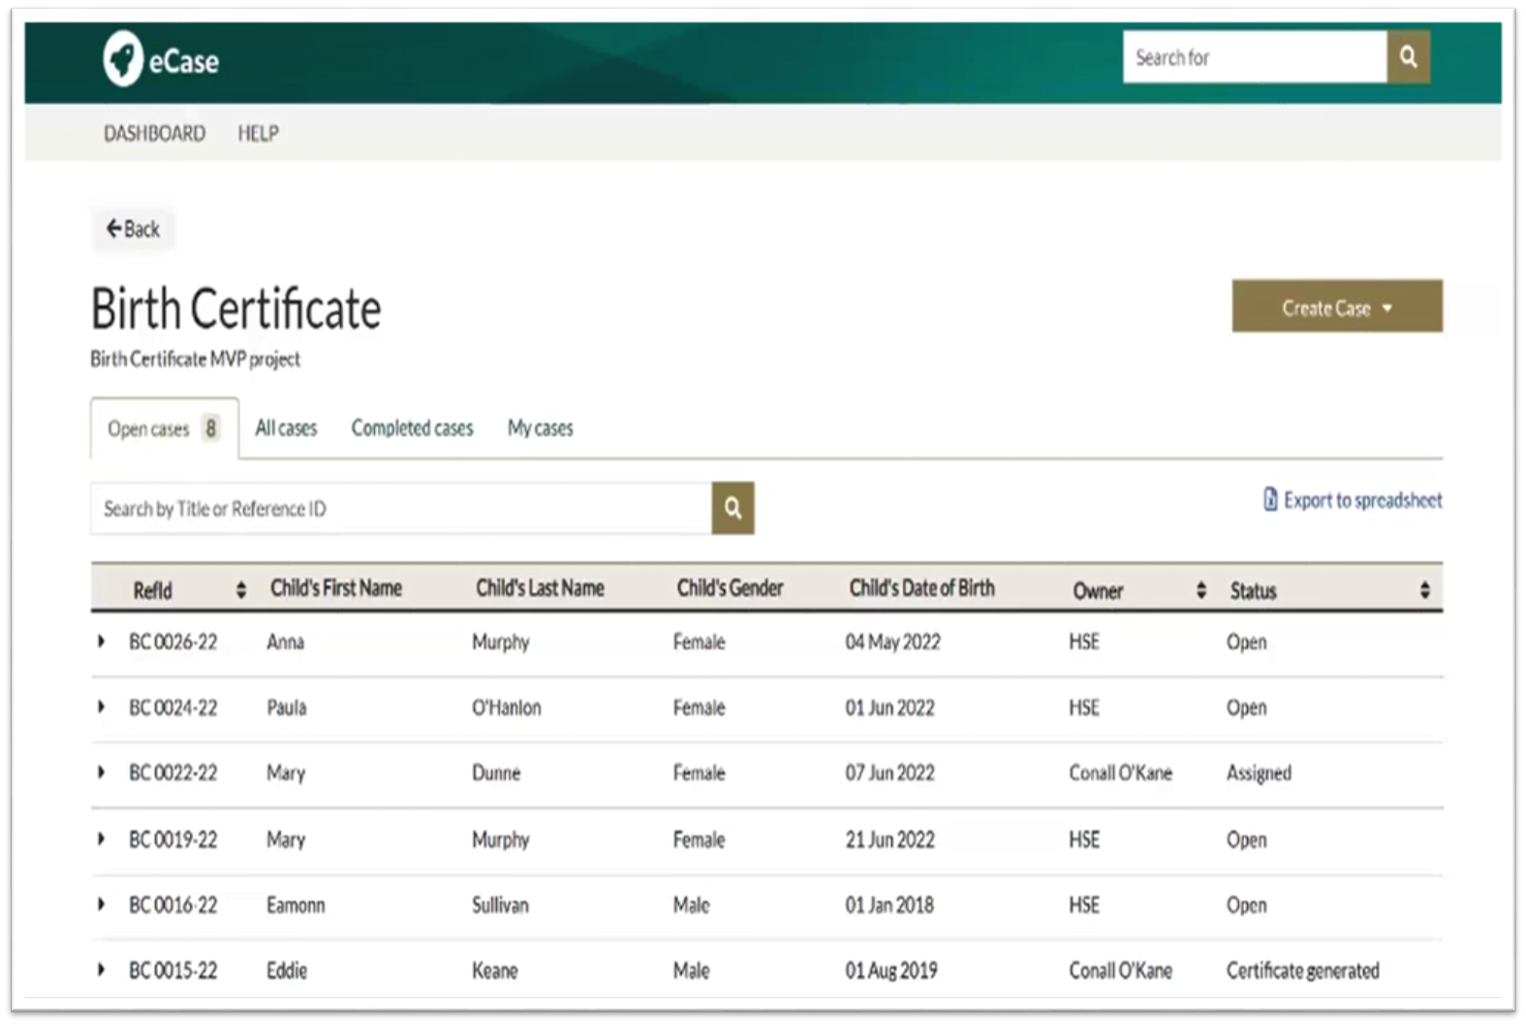
eCase: Case Management

Slide 27
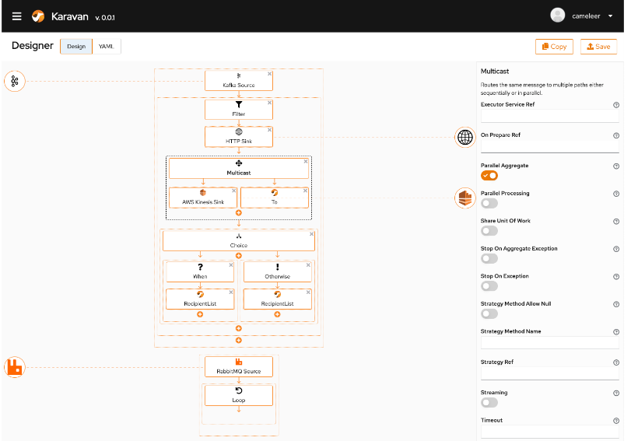
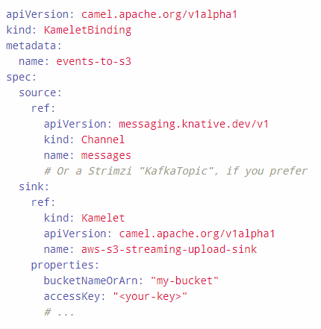
Information Mediator & APIs

Slide 28
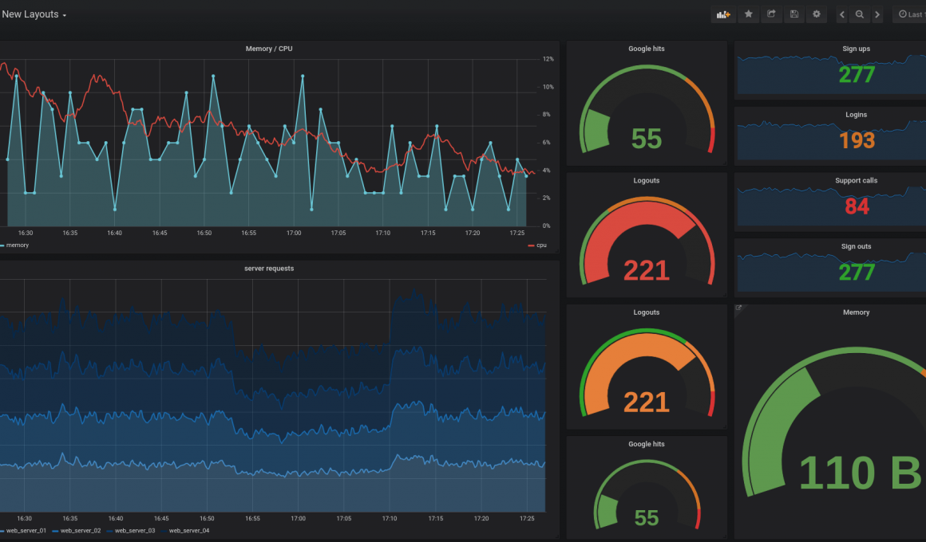
Analytics & Business Intelligence

Slide 29
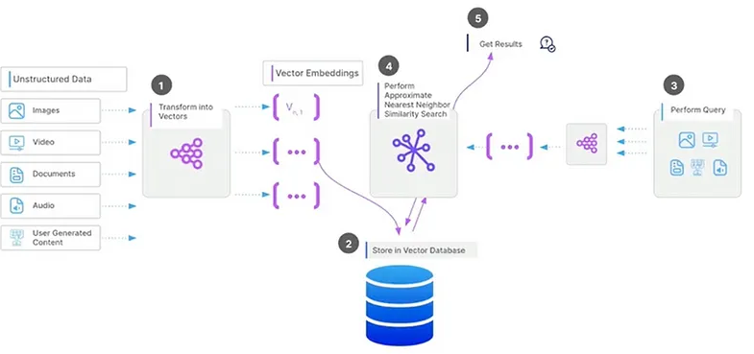
AI Projects & Open Framework

Slide 30
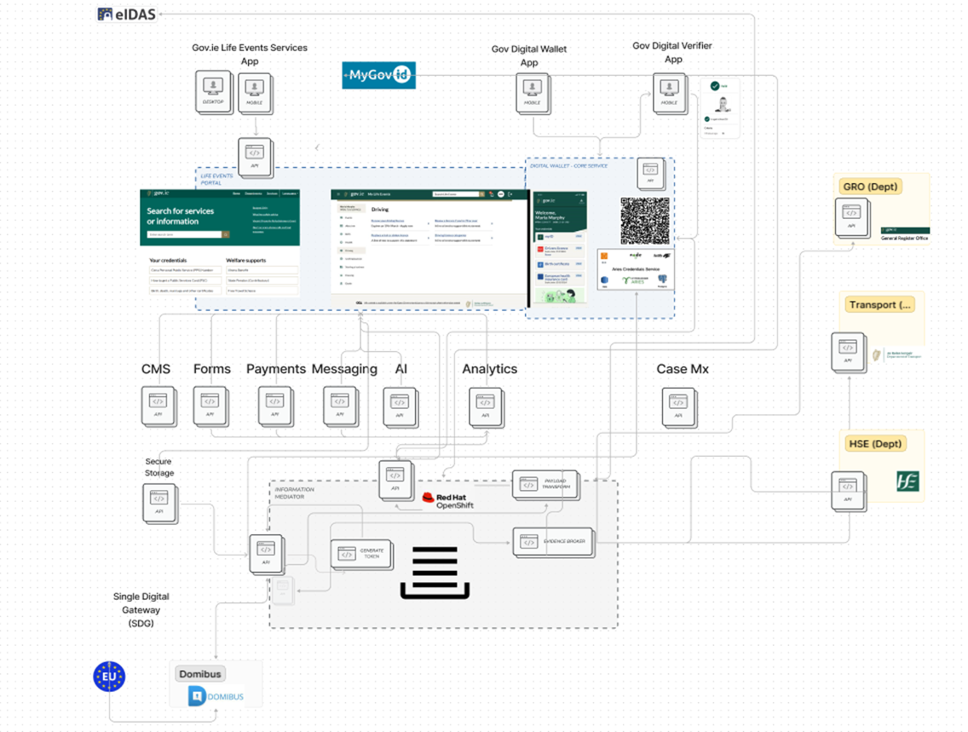
Applications: Federation: Building Blocks

Slide 31
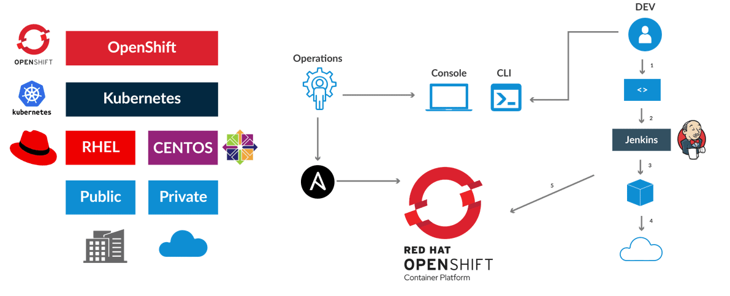
Architecture: Vendor Neutral: InfraStructure

Slide 32
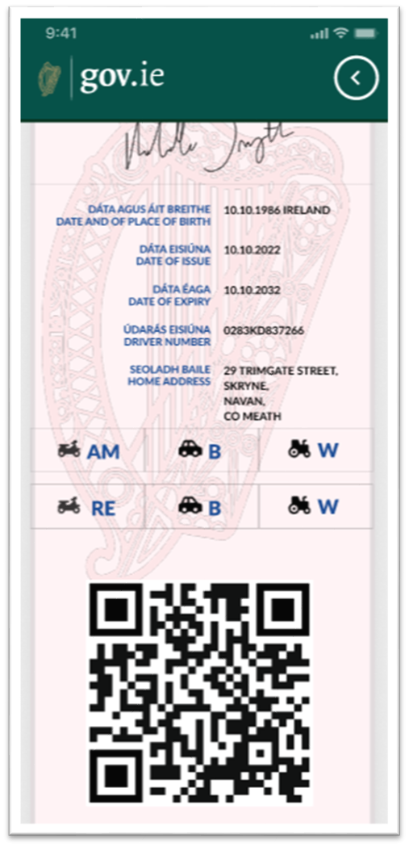
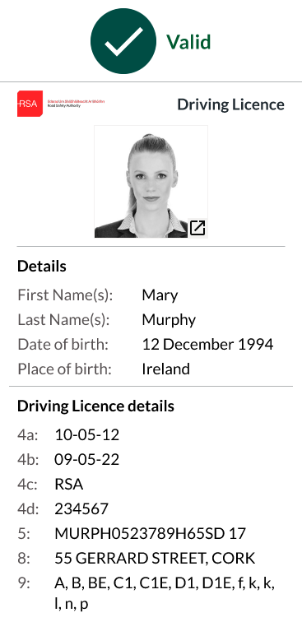
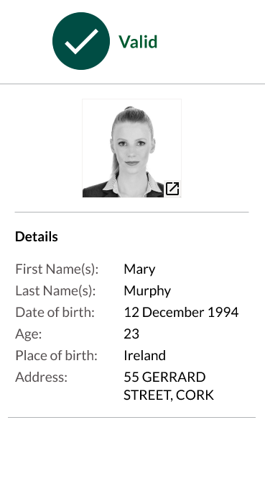
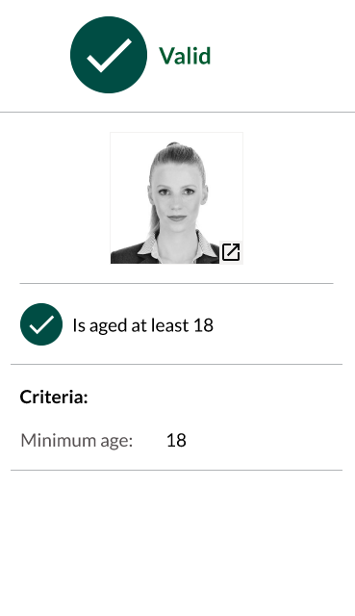
Digital Wallet: Credentials & Verification

Slide 34
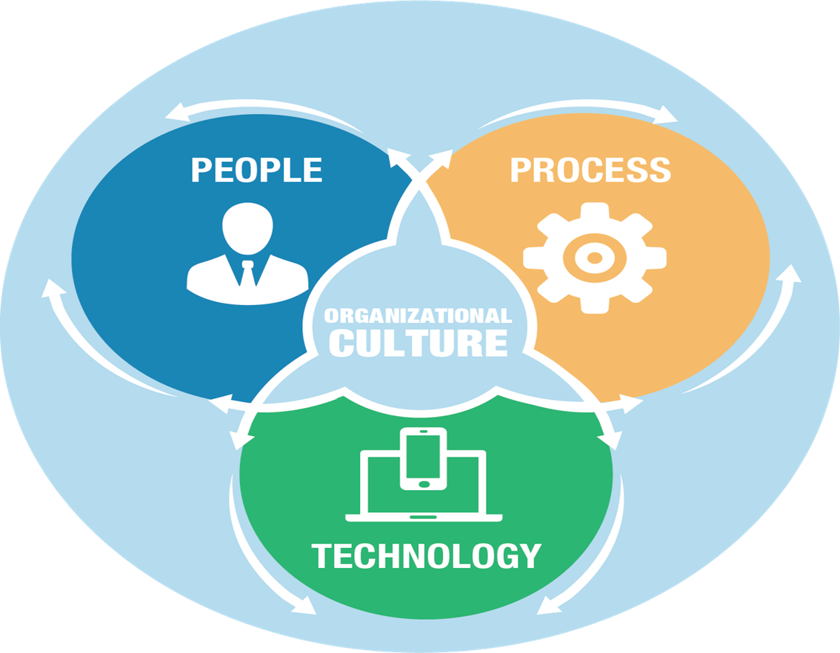
Challenges

Slide 35
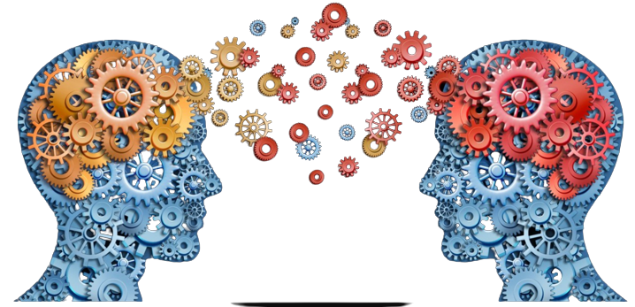
Opportunity

Slide 36




Slide 38

Thank you
Tony Shannon
Head of Digital Services
Office of Government Chief Information Officer
Government of Ireland

Slide 39
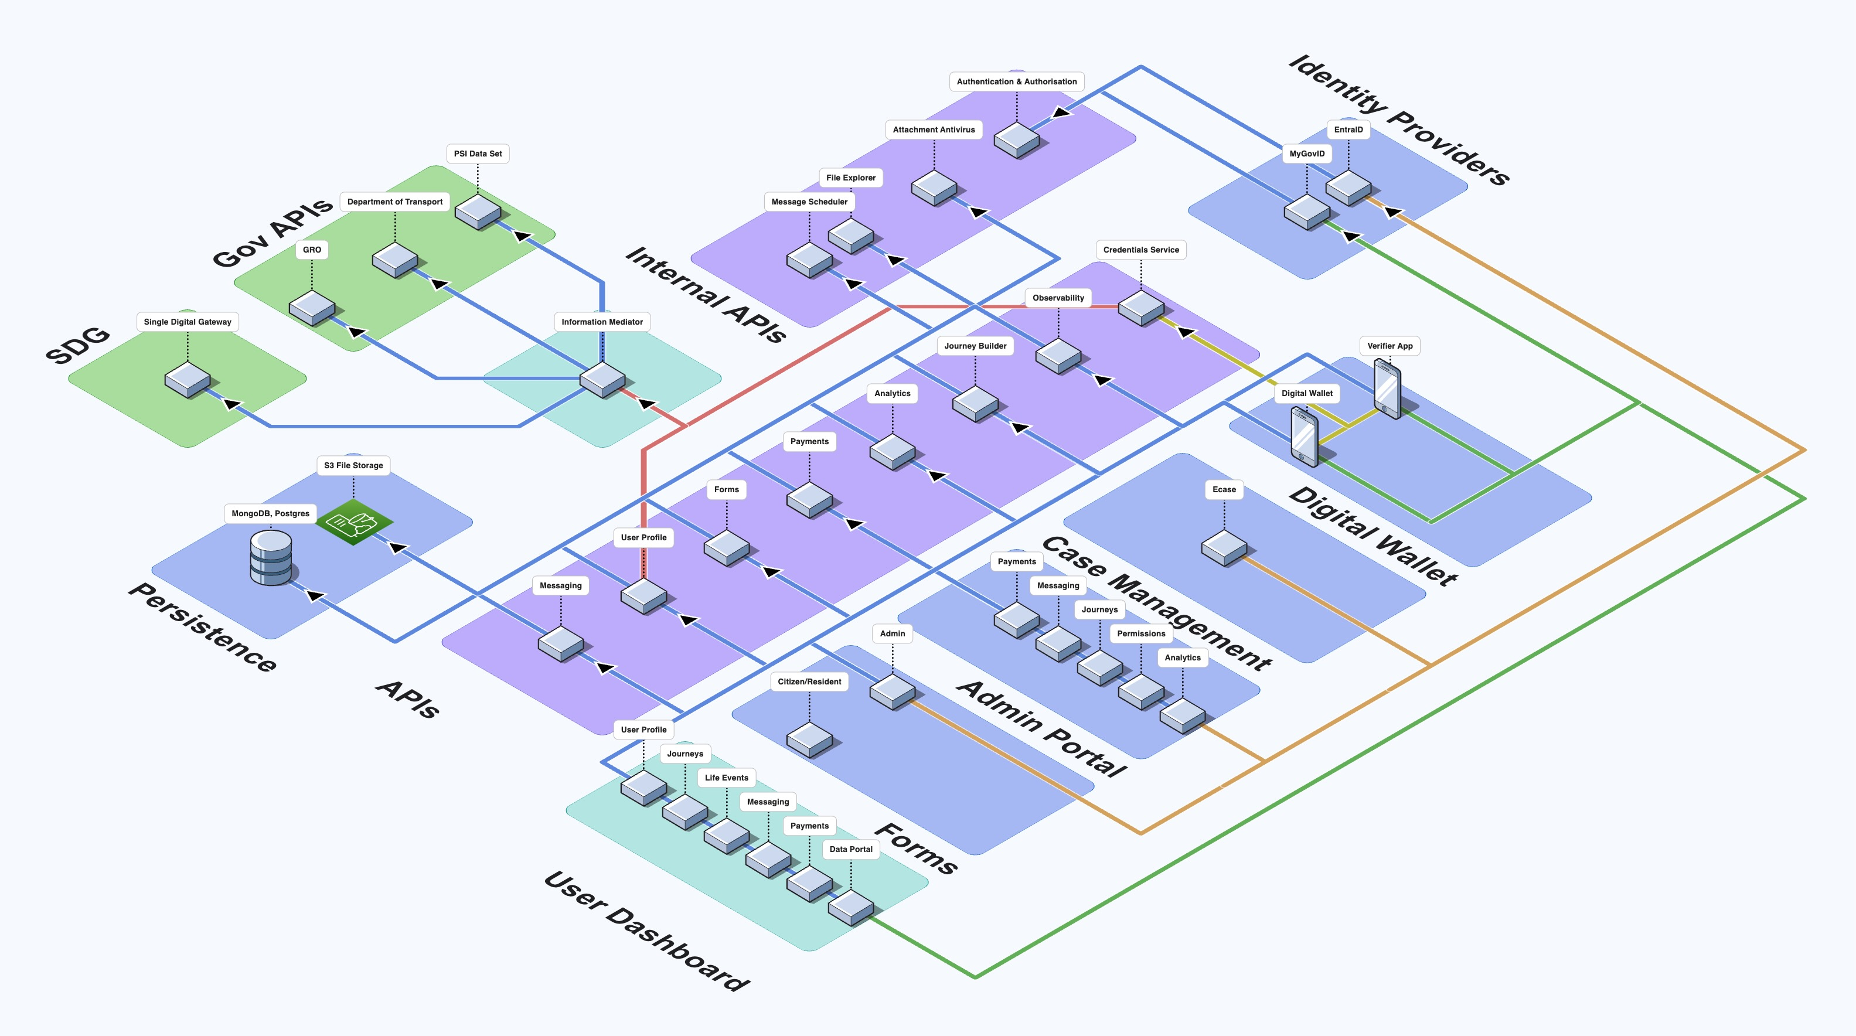

Slide 40
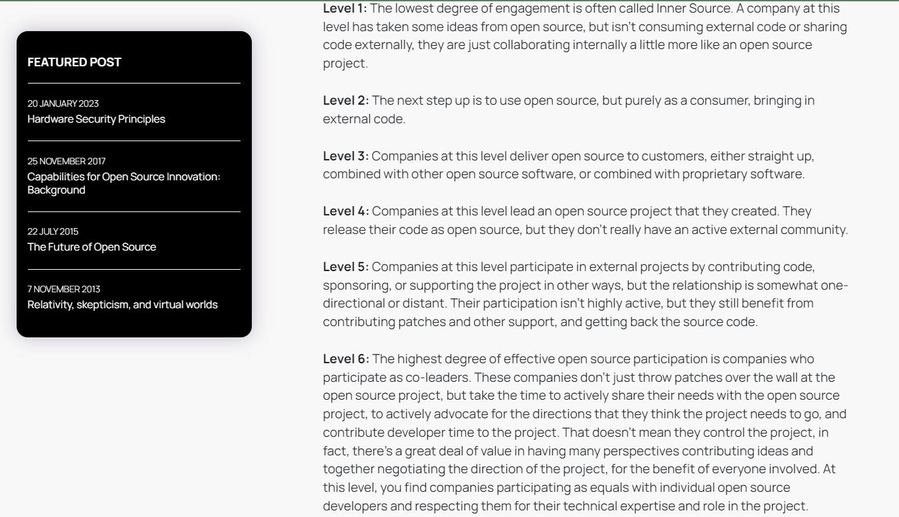
Open Source Maturity Levels

